Slide 1
Can Socioeconomic Factors Predict School Performance on ACT?
Cassidy Denault - DATA 3320

Slide 2
Exploring the Inequality of Educational Opportunity
The ACT and SAT are standardized exams typically taken by high schoolers for college entrance.
Is a student's performance correlated with socioeconomic factors for their area/school?
Could indicate disparity in educational opportunities.

Slide 3
Data Used to Investigate the Relationship
School's average ACT (and SAT equivalent) scores.
Census data on the school's & the school's area socioeconomic factors.
% of students on free and reduced lunch
% of adults with a college degree
rate of unemployment in the area
% children in a married couple family
median household income

Slide 4
Description of Data
Socioeconomic data from the Census Bureau’s American Community Survey 2016-2017.
ACT and SAT score data from Edgap.org.
Showcases data about school's average scores in the US 2016-2017.
Aims to raise awareness of educational disparities related to socioeconomic disparities.
20 States Represented
7,227 Schools Included
Notes:
TX OH PA IL MI FL NC WI NY GA NJ MO IN TN MA WA LA KY WY DE

Slide 5
Analyze by Generating Sub Questions
Is a student's performance correlated with socioeconomic factors for their area/school?
Are all variables statistically significant?
What combination of variables produces the strongest model?

Slide 6
Using Linear Regression Models
Loaded data frames with school's socioeconomic info
Use the smf.ols function to fit a linear regression model to the data
Call the fit() method on the model object to compute the regression coefficients and other statistics

Slide 7
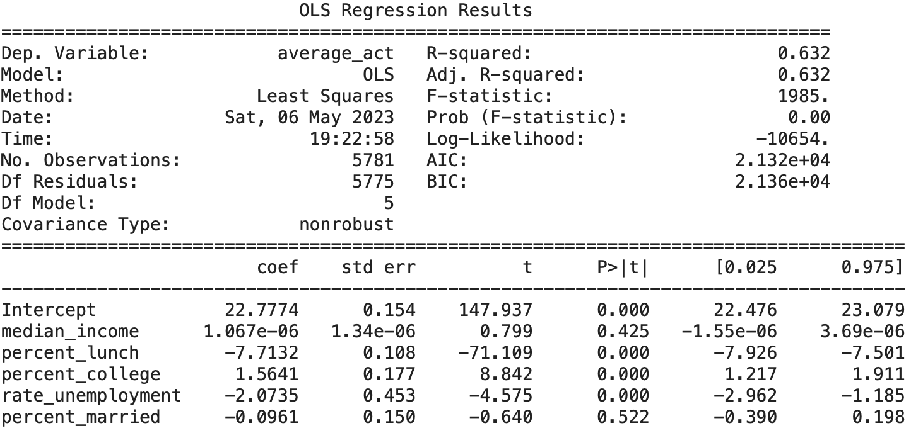
All Inclusive Linear Regression Model is Reasonable
R squared is relatively high, model is a pretty good fit for the data
A higher R squared indicates the model is a good fit for the data

Slide 8
All Inclusive Linear Regression Model is Reasonable
A relatively large absolute value coefficient indicates percent lunch is most dominant influence in model.
P values of predictor variables indicate median income and percent married are not statistically significant to the model
What is the optimal subset of variables that produces the best model?

Slide 9
3 Variables Make the Optimal Model
Used a function to iterate through all possible combinations at all possible sizes
High R squared: 0.632
Low P values throughout
Less variables = less complexity
Optimal Model Predictors
school's percent of adults with a college degree
percent of student's on free and reduced lunch
rate of unemployment in the area

Slide 10
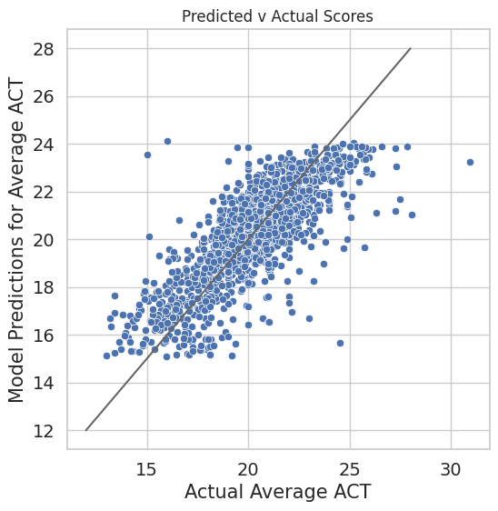
Predictions are Reasonably Accurate
Applied new data to the model
Compared the model's ACT score prediction with actual score
All blue points on gray line would indicate perfect predictions, we are close.

Slide 11
Socioeconomic Factors Can Reasonably Predict Average Scores
As the number of students on​ free/reduced lunch and the rate of​ unemployment increases, and​ percent of adults with a college ​degree decrease...
the average​ ACT/SAT scores decrease.
Best subset model usually off by only 1 ACT point*
*according to mean absolute error

Slide 12
Additionally: Would Adding States Variable Improve Model?
Specifically, Washington and Illinois.
Different regions (PNW & Midwest)
Generally similar politics, incomes, and education systems
Added a categorical predictor to percent lunch variable model
Percent lunch variable model was reasonably as good as optimal subset model

Slide 13
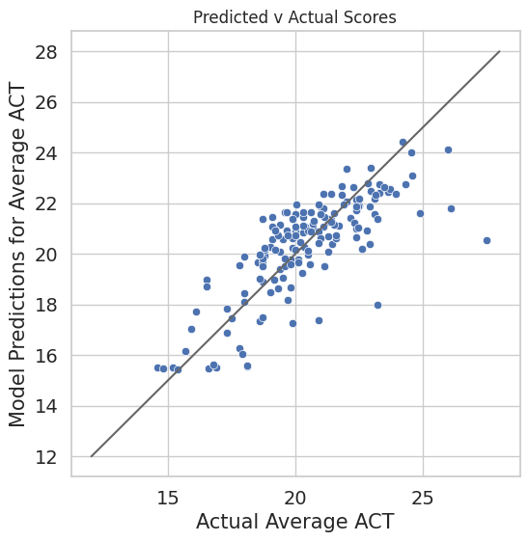
States Model is Slightly Improved
Higher R squared: 0.711 vs 0.632
Low P values throughout
When predicting off new data
Actual vs predicted generally fall in area of the line and trend in the same direction.
Model usually only off by about 1 ACT point (mean absolute err)

Slide 14
Adding States Variable Improves Model by Marginal Amount
Illinois has overall lower scores than Washington at the same levels of students on free and reduced lunch, but as the percent increases, both states see a decrease in average ACT scores
Worthwhile? Depends on resources and time, adding this variable took more

